Slide 1
How does European policy affect farming in mountain areas?
Blandine Camus, Communication & Policy Officer, Euromontana
Development of agriculture and progress in areas with natural constraints
Bled – 28 November 2022

Slide 2
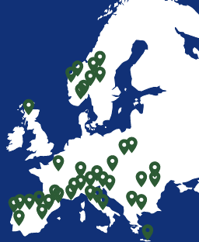
What is Euromontana?
European multisectoral association for cooperation and development of mountain areas (since 1996)
Around 70 members from 17 countries
Including:
regional and local authorities
regional development agencies
chambers of commerce and industry
agriculture organisations
environmental organisations
research organisations
training institutes…

Slide 3
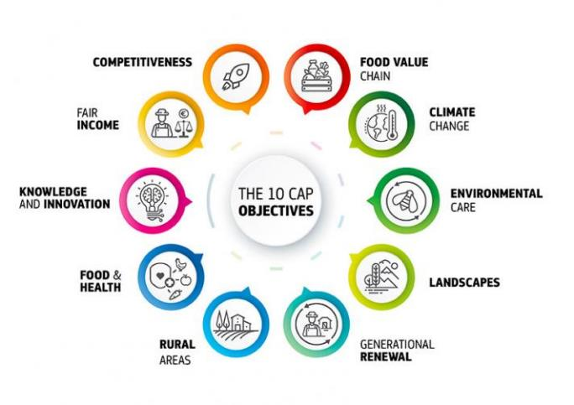
Post-2022 CAP
Notes:
Of course the 1 policy is mind regarding agriculture is the CAP. With the new delivery model and 1 SP per country. Not all SP are adopted yet. So far, hard to have a clear picture of all the measures included in the different SP. We plan to do a study on this once we can access the final approved SPs.

Slide 4
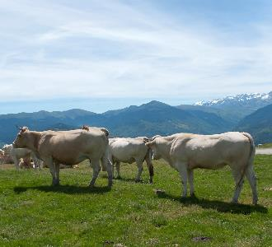
Post-2022 CAP: France
ANC payment
ANC payment proposed, with a total budget of 1.1 billion per year
Coupled payments:
Coupled aid for sheep and goat production and cattle breeding
Coupled aid for fodder legumes in mountain areas
Eco-schemes:
maintenance of unploughed permanent grassland for at least 5 years
Other support:
Aid for livestock guarding
Aid for investments in protection against predation

Slide 5
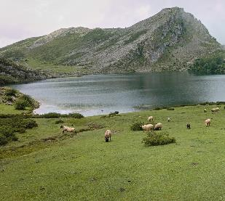
Post-2022 CAP: Spain
ANC payment
ANC payment proposed, with specificities in each region
Asturias and Navarra minimum eligible area of 2 ha or in Castilla y León 3 ha
Navarra maximum eligible area of 100 ha but 75 Valencia
Cantabria, in order to receive the ANC, no retirement or unemployment pension must be received
Coupled payment
Couple aid for the production of sustainable cow milk
Eco-scheme
Extensive grazing on wet and Mediterranean pastures
At least 120 days per year
Livestock density fixed

Slide 6
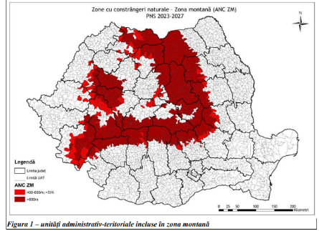
Post-2022 CAP: Romania
ANC payment
ANC payment proposed, 40e/ha/year with degression of aid from 50 ha
Coupled payments:
Coupled aid for sheep and goat production and cattle breeding
Eco-schemes:
Not directly aimed at mountain areas
Other:
Emphasis on quality schemes and ”mountain products”

Slide 7
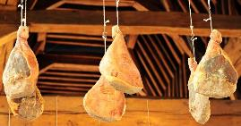
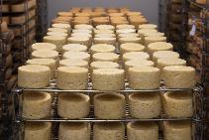
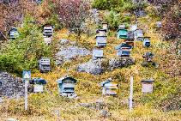
EU legislation on Mountain Products
Regulation 1151/2012 + Delegated Act 665/2014
Both the raw materials and the feedstuffs for farm animals come essentially from mountain areas
Processed products: the processing also takes place in mountain areas
Notes:
mountain areas within the Union are those delimited pursuant to Article 18(1) of Regulation (EC)
No 1257/1999:
Article 18
1. Mountain areas shall be those characterised by a considerable limitation of the possibilities for
Using the land and an appreciable increase in the cost of working it due:
–to the existence, because of altitude, of very difficult climatic conditions, the effect of which is substantially to shorten the growing season,
– at a lower altitude, to the presence over the greater part of the area in question of slopes too steep for the use of machinery or requiring the use of very expensive special equipment, or
– to a combination of these two factors, where the handicap resulting from each taken separately is less acute but the combination of the two gives rise to an equivalent handicap.
2. Areas north of the 62nd Parallel and certain adjacent areas shall be treated in the same way as mountain areas.
Products of animal origin:
2/3 life in mountain areas
at least ¼ life in transhumance grazing on pastures in mountain areas
Feedstufs:
% of annual animal diet (expressed as a % of dry matter) produced in mountain areas should be 50% for all animals but 60% for ruminants, 25% for pigs
Processed or unprocessed animal products, e.g. milk, dairy products, cheeses, meat, meat products, eggs, etc.
Bee products, e.g.: honey, pollen, solid propolis.
Processed or unprocessed plant products, e.g. jams, jams, syrups, teas, plants and fruits of culture or from spontaneous flora, raspberries, blueberries, vegetables, potatoes, mushrooms, etc.

Slide 8
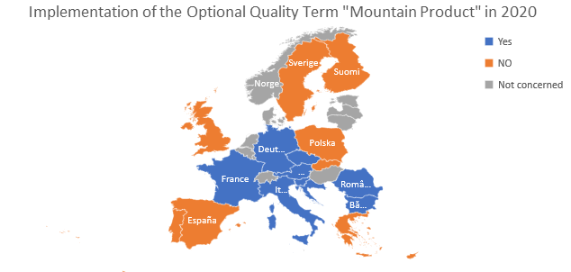
EU Optional Quality Term

Slide 9
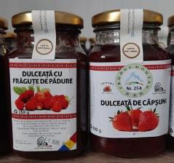
Romania
Law from 2016
Pre-authorisation for farmers ➔ database
Use of a national logo
3246 products registered, more than 1000 producers (2022 figure)
Notes:
Adaptation process at national level: law in 2017
Derogation on distance of processing: Romania is the only country so far who decided not to use any derogation (reducing the distance to 0km).
Procedure for authorization of use: a pre-authorisation requested by farmers to be validated by the Mountain Area Agency
Producers’ uptake of the OQT: Since July 2017, 573 products registered : 264 dairy and dairy products, 9 meat and meat products, 183 fruits and vegetables, 107 bee products, 9 fish products and 1 bread, bakery and pastry product. The full database is available here.

Slide 10
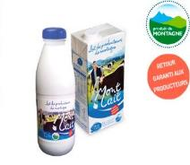
France
Law from 2015
No pre-authorisation or notification
A good uptake but no official database
No official logo
Notes:
Adaptation process at national level: in 2015 ordinance nº2015-1246 on signs for the indication of quality and origin. It introduced two distinct cases:
For the food products mentioned in the Annex I of the Treaty on the Functioning of the European Union as stated in the article 31 of the regulation (EU) N°1151/2012, the EU OQT “mountain product” should be used.
For drinks and other non-food agricultural products (like water for example) that are not subject to the EU regulations and that were included in the previous French regulation, the national term ‘mountain’ is maintained.
Derogation on distance of processing: 30 km (no reduction)
Procedure for authorization of use:
For both the EU term and the national term, the producers will no longer need an authorisation before making use of these terms (as it was the case under the previous national legislation).
encouraged to inform the DRAAF (Regional Direction in charge of Agriculture, Food and Forestry in each French region) that they are using the term.
Producers’ uptake of the OQT: no official number – no official logo

Slide 11
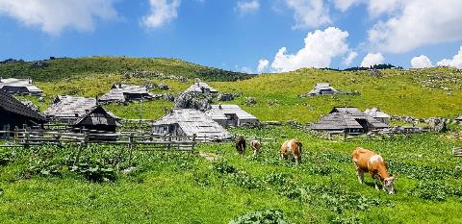
Slovenia
Law from 2014 & 2015
No pre-authorisation for farmers ➔ only notification of use
No logo
Only 1 producer in 2020
Notes:
Adaptation process at national level: law in 2017
Derogation on distance of processing: Romania is the only country so far who decided not to use any derogation (reducing the distance to 0km).
Procedure for authorization of use: a pre-authorisation requested by farmers to be validated by the Mountain Area Agency
Producers’ uptake of the OQT: Since July 2017, 573 products registered : 264 dairy and dairy products, 9 meat and meat products, 183 fruits and vegetables, 107 bee products, 9 fish products and 1 bread, bakery and pastry product. The full database is available here.

Slide 12
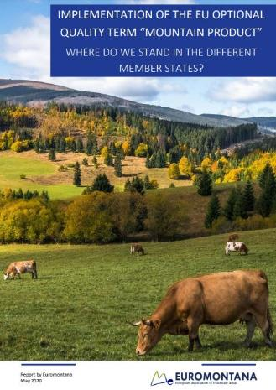
EU Optional Quality Term
Euromontana study on the implementation of the EU optional quality term (2020)
https://www.euromontana.org/en/implementation-of-the-eu-optional-quality-term-mountain-product-new-euromontana-study/

Slide 13
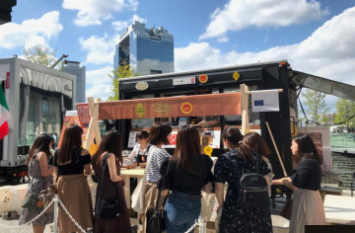
EU Promotion Policy
An EU policy to fund communication campaign on agri-food products
Annual calls (€185.9 million euros in 2022)
Wide communication campaign (TV, radio, chefs, influencers, agri fairs)
Lines for organic products, quality scheme & mountain products, fresh vegetables …
A way to raise awareness on the benefits of mountain farming

Slide 14
EU Promotion Policy
Revision process since 2021
Possible exclusion of some products
Meat and dairy products represent 22% and 29% of the agricultural output from mountain farms
Capitalise on the existence of sustainable animal products
Raise awareness among consumers
Strengthen sustainable value chains
Notes:
Objective of the revision: make the PP more sustainable (F2F + action plan action cancer)
European Commission announced 3 options for the new PP. Announcement during the CDG Quality & Promotion (importance of being part of the expert group). 3 options:
No change, each year we decide if there are new priorities for the calls to come. If yes, then we create a specific topic (ex: 2021 sustainability topics)
On external market focusing on competitiveness, on internal market on sustainability = promoting GIs outside the EU and sustainable products inside the EU
Putting strict criteria to select the type of products eligible = risk for meat products

Slide 15
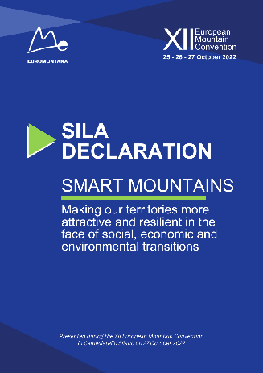
Future-oriented agriculture
Recognises the role of agriculture for ecosystem services
Need to support mountain farming towards resilience
Notes:
Objective of the revision: make the PP more sustainable (F2F + action plan action cancer)
European Commission announced 3 options for the new PP. Announcement during the CDG Quality & Promotion (importance of being part of the expert group). 3 options:
No change, each year we decide if there are new priorities for the calls to come. If yes, then we create a specific topic (ex: 2021 sustainability topics)
On external market focusing on competitiveness, on internal market on sustainability = promoting GIs outside the EU and sustainable products inside the EU
Putting strict criteria to select the type of products eligible = risk for meat products

